Slide 1


Lok Sabha Election Analysis
Prepared by
Name – Ayush Patel
Enrollment No - 210670107089
Guided By – Prof. Ajeet Patel
Computer Engineering
SAL INSTITUTE OF TECHNOLOGY AND ENGINEERING RESEARCH

Slide 2
Contents
Abstract
List of Figures |  |  | i
List of Table Company Profile |  |  | ii
1 |  | Introduction | 1
 | 1.1 | Project Summery /Introduction of [Summer Internship/Mini Project Name/Specification/Seminar] | 2
 | 1.2 | Aim and Objectives
 | 1.2 | Tools & Technologies
2 |  | Implementation
 | 2.1 | Functional
 |  | Non Functional Result screen shots with explanation
3 |  | Outcomes
 | 3.1 | Conclusion
 | 3.2 | Future Enhancement
4 |  | Bibliography (Include only website links or book name or research papers)

Slide 3
Abstarct
The proposed system on Lok Sabha Elections Analysis aims to explore key aspects of India's elections over the past 20 years, analyzing data from 2004 to 2024. Utilizing tools like Power BI for analysis and visualization, along with Pandas, Numpy, and Matplotlib libraries through Python, this system provides comprehensive insights into voter turnout, candidate demographics, and political party performance.The analysis focuses on voter turnout, candidate demographics, and political party performance, incorporating statewise results for comprehensive insights.
The main goals are to understand trends in voter participation, examine all winning candidates, and assess the performance of major parties. Additionally, the analysis studies voting patterns across different regions and evaluates the impact of electoral size and demographics.
By carefully collecting and preparing the data, the system ensures accurate and meaningful analysis. Visualizations are used to present the results, making it easy to identify important trends and patterns.
This analysis aids in understanding how voter behaviour has changed over time, the role of different demographic factors, and the evolution of political strategies. Overall, the project provides valuable insights into India's Lok Sabha elections, offering useful information for political strategists, researchers, and policymakers to make better decisions for future elections.

Slide 4

Company Profile
Name:- Grownited private limited
Address:- 301-305, 3rd Floor, Surbhi Complex, Nr. Municipal Market, Chimanlal Girdharlal Road, Navrangpura,Ahmedabad Gujarat- 380009
Phone No: 7874014621
About:- Software development company

Slide 5
Chapter-1 Introduction
1.1 Project Summary of Lok Sabha Election Analysis
The Lok Sabha Election Analysis project examines India's parliamentary elections from 2004 to 2024 using Power BI and Python for data analysis and visualization. It aims to uncover trends in voter turnout, candidate demographics, and political party performance over two decades. The insights gained will support political strategists, researchers, and policymakers in understanding voter behavior and shaping future electoral strategies.
The project leverages advanced data analysis techniques to explore regional voting patterns and the impact of demographic factors on election outcomes. By providing a detailed examination of electoral trends, it aims to highlight shifts in voter preferences and party dynamics. The findings will offer valuable guidance for crafting more effective campaign strategies and policies, contributing to a deeper understanding of India's evolving political landscape.

Slide 6
1.2 Aim and Objectives
Aim of Project
Measure the performance of major political parties over the last 20 years.
Examine trends and changes in voter participation across different elections and regions.
Understand the relationship between demographic factors and electoral results, focusing on the size and composition of the electorate.
Use advanced data analysis and visualization tools to present clear and actionable insights for stakeholders.
Objectives
To analyze voter turnout and participation trends from 2004 to 2024.
To assess the performance of major political parties and the emergence of regional parties.
To explore regional voting patterns and the urban-rural divide.
To evaluate the impact of electoral reforms and technology on the election process.

Slide 7
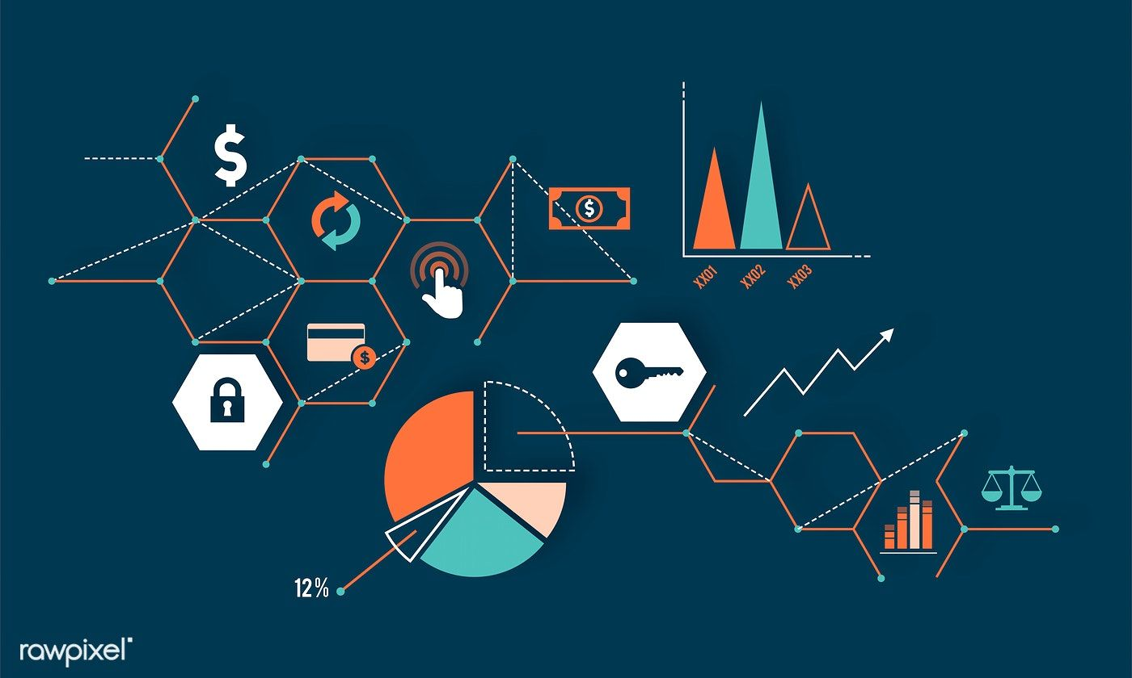
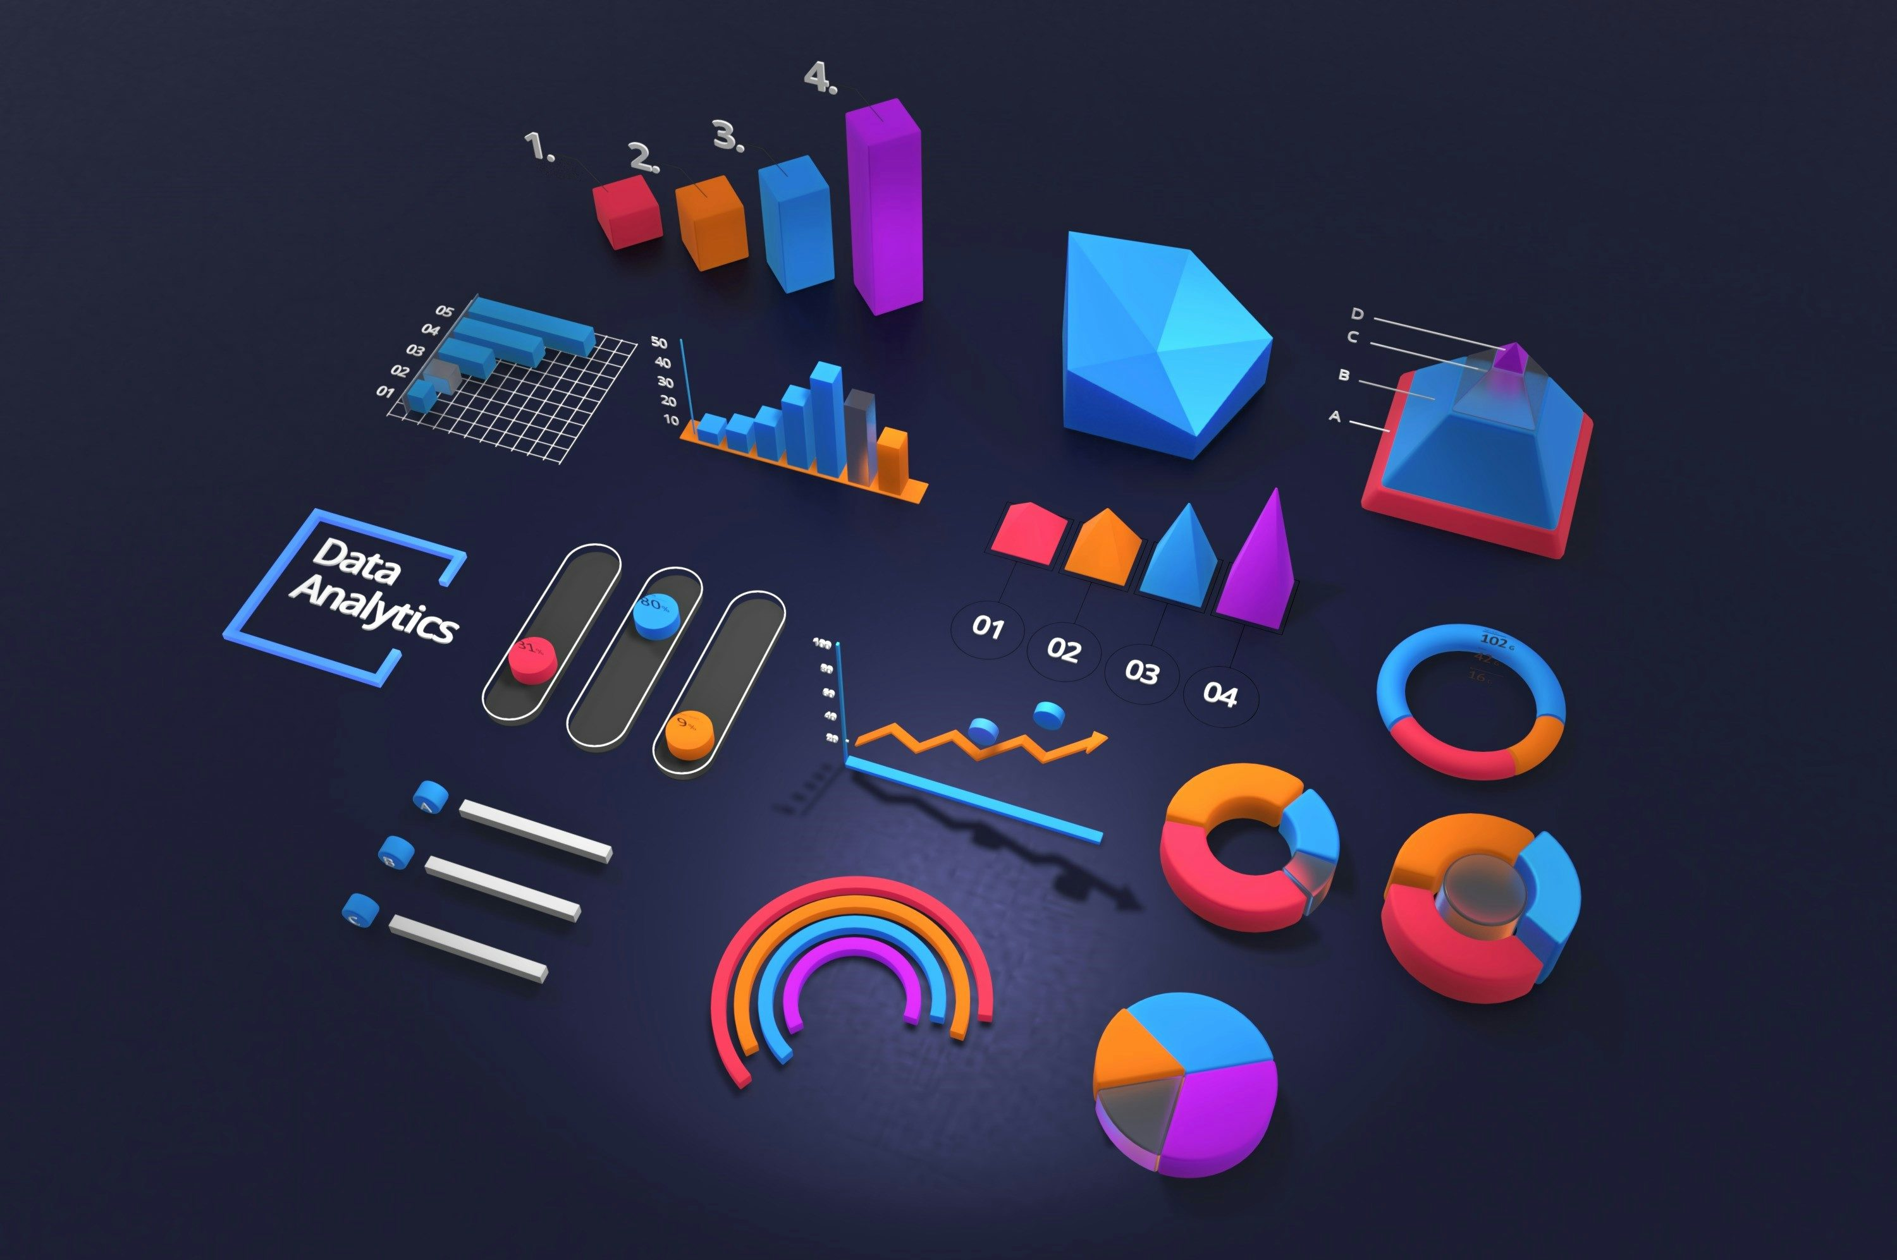





1.3 Tools & Technologies
Tools & Technologies

Slide 8



Tools & Technologies
Tools & Technologies

Slide 9
Power Bi
Power BI is a suite of business analytics tools that deliver insights throughout your organization. It helps in connecting to hundreds of data sources, simplifying data preparation, and driving ad hoc analysis. With Power BI, users can produce beautiful reports and publish them for their organization to consume on the web and across mobile devices.
Tools & Technologies

Slide 10
Google Colab
Google Colab is an online Jupyter notebook environment hosted by Google. It allows users to write and execute Python code directly in their web browser, making it accessible from any device with an internet connection. Colab provides the computational resources, such as CPUs and GPUs, required to run code efficiently, which is especially beneficial for tasks involving large datasets and complex computations.
Tools & Technologies

Slide 11
Python Libraries
Pandas is a powerful, open-source data manipulation and analysis library for Python. It provides data structures and functions needed to manipulate numerical tables and time series data.
Matplotlib is a comprehensive library for creating static, animated, and interactive visualizations in Python. It is highly customizable and widely used for creating publication-quality plots and graphs.
Seaborn is a Python data visualization library based on Matplotlib that provides a high-level interface for drawing attractive and informative statistical graphic
BeautifulSoup is a Python library used for web scraping purposes to pull the data out of HTML and XML files.
Tools & Technologies

Slide 12
Excel
Microsoft Excel is a spreadsheet program that allows users to organize, format, and calculate data using a system of rows and columns. It is a versatile tool that can be used for various purposes, including data analysis, financial modelling, project management, and more. Excel's interface consists of a grid of cells, each of which can contain numbers, text, formulas, or functions.
Tools & Technologies

Slide 13
Power Query
Power Query is a data transformation and data preparation engine. It allows users to extract data from various sources, transform it to meet their needs, and load it into Excel or Power BI for further analysis. Power Query provides an intuitive, userfriendly interface for data manipulation, making it accessible to both technical and non-technical users.
Tools & Technologies

Slide 14
Jira
Jira is a comprehensive and flexible project management tool that supports various methodologies and use cases. Its powerful features for issue tracking, agile project management, collaboration, and reporting make it an essential tool for software development teams and organizations managing complex projects. Whether you are tracking bugs, planning sprints, or managing business processes, Jira provides the tools and capabilities needed to streamline your workflows and achieve your project goals.
Tools & Technologies

Slide 15





Git Hub
GitHub is an essential tool for modern software development, providing powerful version control, collaboration, and project management capabilities. Its wide range of features, active community, and seamless integrations make it an invaluable resource for developers, teams, and organizations working on projects of all sizes and complexities. Whether you are developing proprietary software, contributing to open-source projects, or managing a complex development pipeline, GitHub offers the tools and support needed to succeed.
Tools & Technologies
Data Collection Phase
Collected data from sources like the Election Commission of India, Wikipedia, and India Votes, using Power Query for web scraping and preprocessing candidate, vote, party, and constituency details.
01
Data Cleaning and Preprocessing Phase
Cleaned and preprocessed the data for analysis using Python and Pandas; such as handling missing values, normalization, removing unnecessary column, etc.
02
Data Analysis Phase
Using NumPy and Pandas, we analyzed voter turnout trends, winning margins, electorate size impacts, state-wise party performance, and turnout vs. winning candidate and margin percentage.
03
Visualization Phase
The analyzed data is visualized using Power BI, focusing on creating interactive dashboards and visualizations that effectively communicate the insights derived from the data.
04
Reporting Phase
The final phase involves compiling the analysis and visualization results into a comprehensive report that includes detailed findings, interpretations, and recommendations based on the analyzed data.
05

Slide 16
Chapter-2 Implementation
2.1 Functional
Data Collection Phase
Collected data from sources like the Election Commission of India, Wikipedia, and India Votes, using Power Query for web scraping and preprocessing candidate, vote, party, and constituency details.
Data Cleaning and Preprocessing Phase
Cleaned and preprocessed the data for analysis using Python and Pandas; such as handling missing values, normalization, removing unnecessary column, etc.
Data Analysis Phase
Using NumPy and Pandas, we analyzed voter turnout trends, winning margins, electorate size impacts, state-wise party performance, and turnout vs. winning candidate and margin percentage.
Visualization Phase
The analyzed data is visualized using Power BI, focusing on creating interactive dashboards and visualizations that effectively communicate the insights derived from the data.
Reporting Phase
The final phase involves compiling the analysis and visualization results into a comprehensive report that includes detailed findings, interpretations, and recommendations based on the analyzed data.
01
02
03
04
05

Slide 17
2.2 Non-Functional
Performance
Ensure the system can handle large datasets efficiently.
Optimize data processing and visualization generation for quick response times.
Scalability
Design the system to accommodate future data expansions and additional election cycles.
Ensure the system can scale to handle increased data volume and user load.
Usability
Ensure a user-friendly and intuitive interface.
Provide clear navigation and accessible features.
Reliability
Ensure the system is reliable and available with minimal downtime.
Implement backup and recovery mechanisms to protect against data loss.
Maintainability
Develop the system with modular and well-documented code for easy maintenance.
Ensure the system can be updated and improved over time without significant disruptions.
01
02
03
04
05

Slide 18
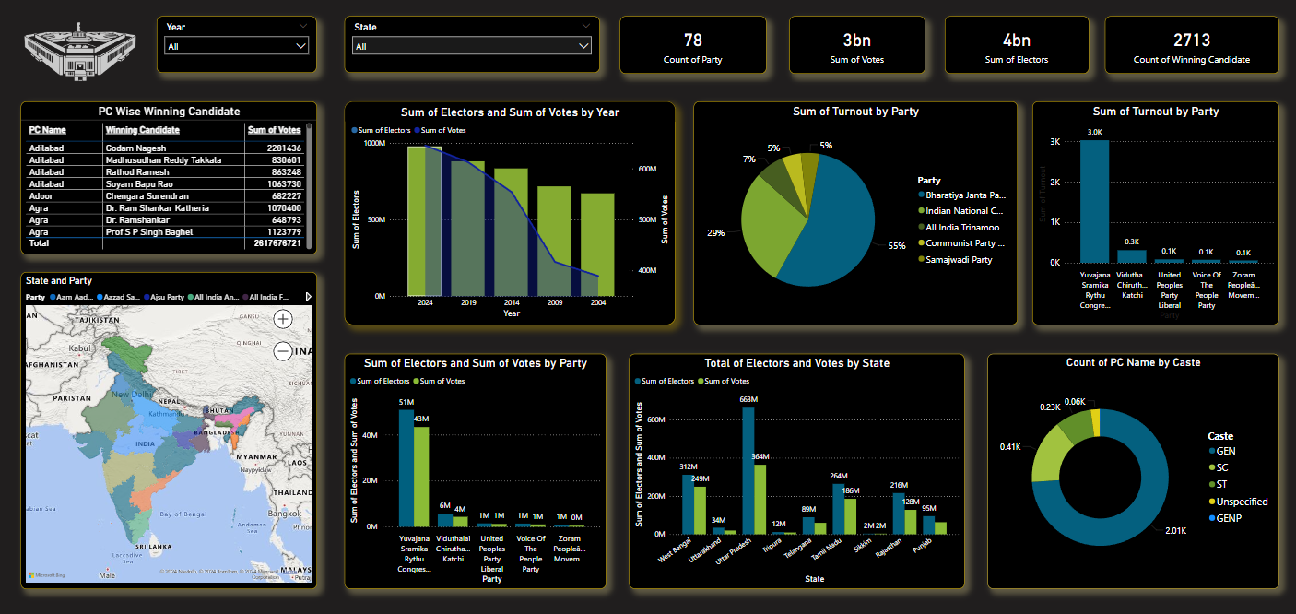
2.3 Result screen shots with explanation
Dashboard
This dashboard provides an analysis of Indian election data, featuring various visualizations. Key metrics include vote counts, elector counts, and winning candidates by year, state, party, and caste. The visualizations include bar charts, pie charts, and a map to illustrate geographic distribution. The data spans from 2004 to recent elections, highlighting trends in voter turnout and party performance. Additionally, the dashboard shows the total votes and electors by state, offering insights into regional variations. It also breaks down the count of winning candidates by caste, showing the representation across different demographics. Overall, this comprehensive analysis aids in understanding the electoral landscape and voter behaviour in India.

Slide 19
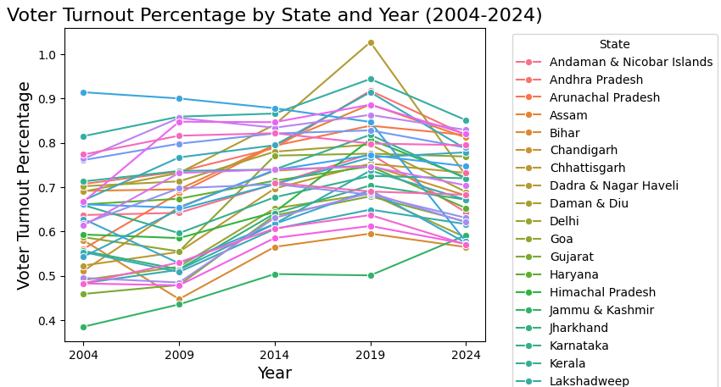
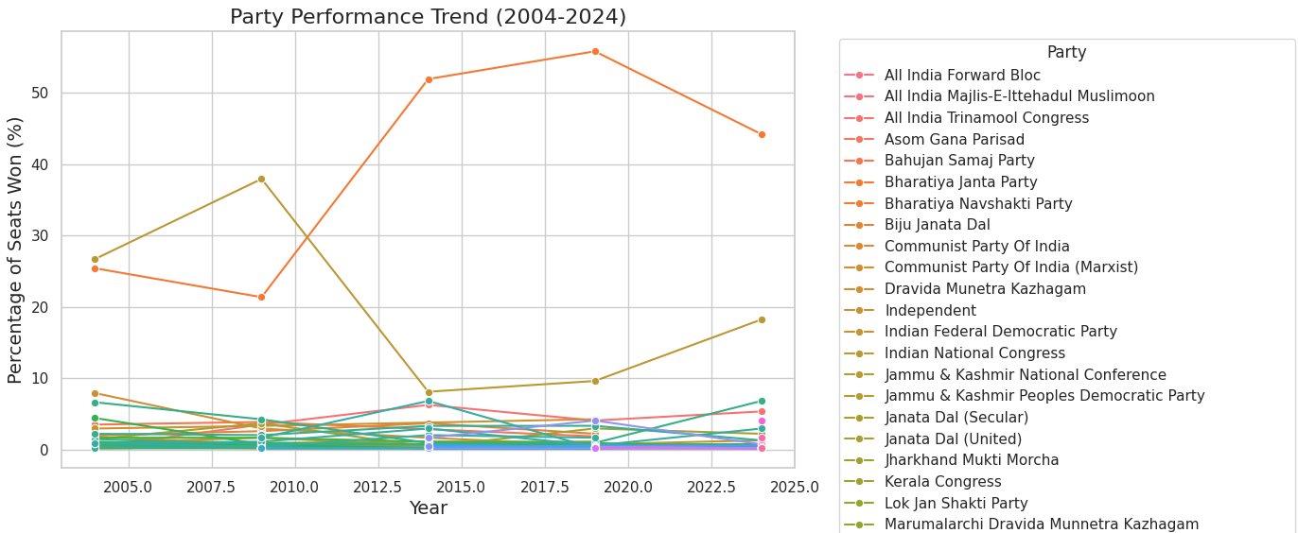
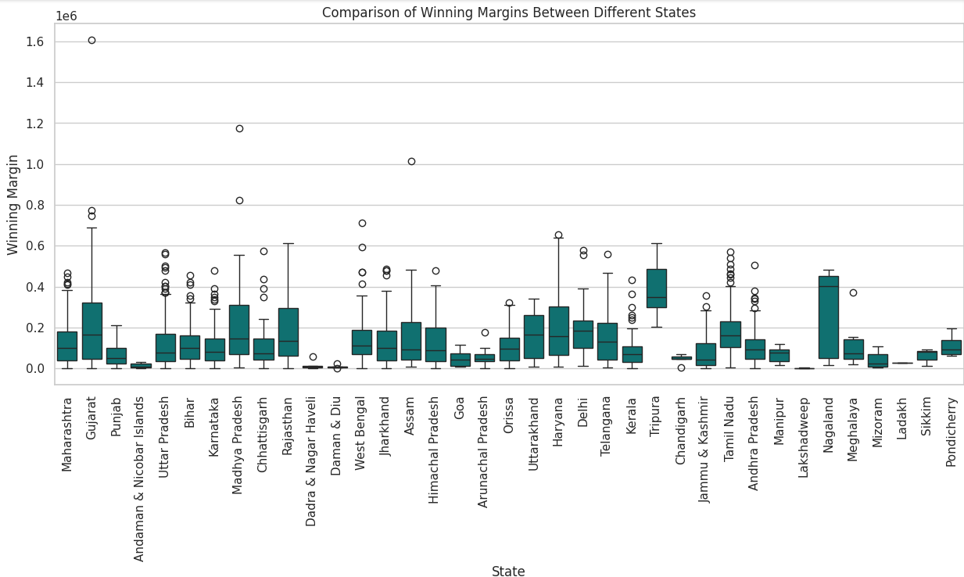
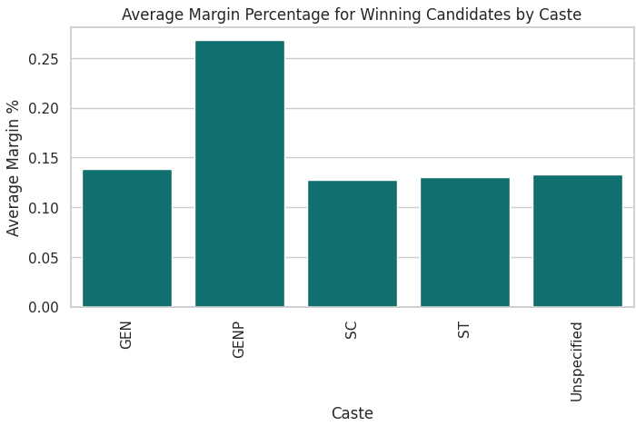
Analyzing voter turnout
How does the voter turnout percentage vary across different states in the 2024 Lok Sabha election?

Slide 20
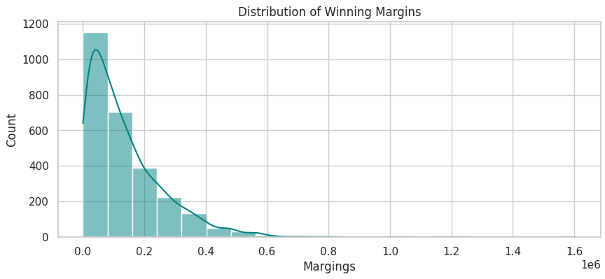
Analyzing voter turnout
How does the voter turnout percentage vary across different states in the 2024 Lok Sabha election?

Slide 21
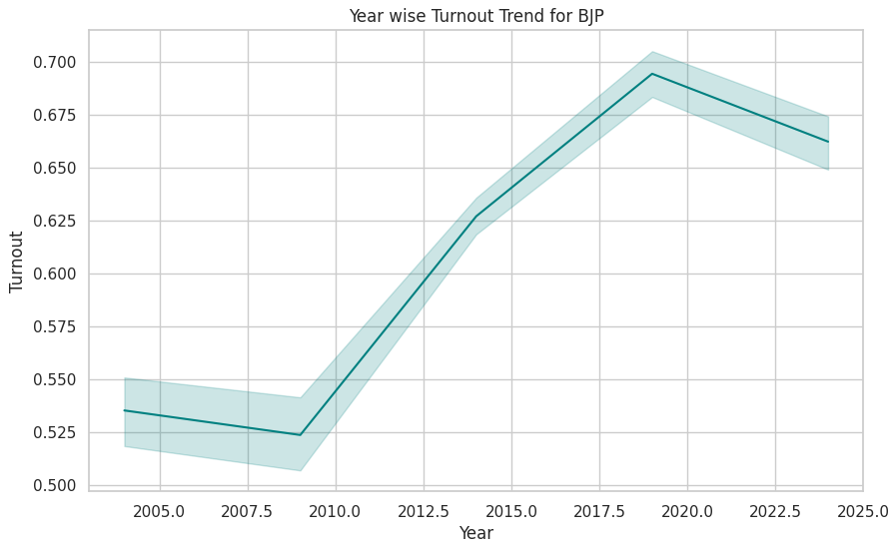
Winning Margin analysis
How does the voter turnout percentage vary across different states in the 2024 Lok Sabha election?

Slide 22
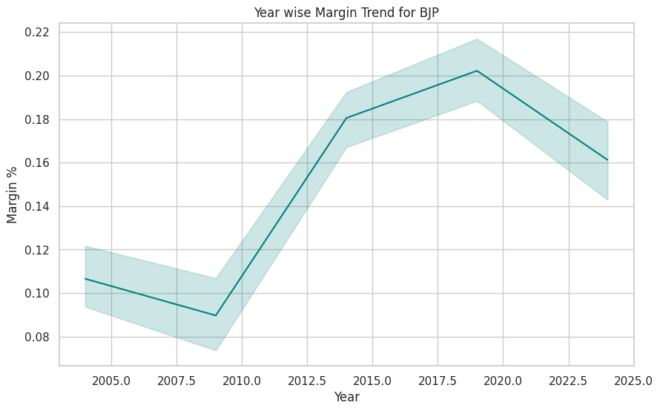
Margin percentage analysis
What is the average margin percentage for winning candidates in constituencies with different majority castes?

Slide 23
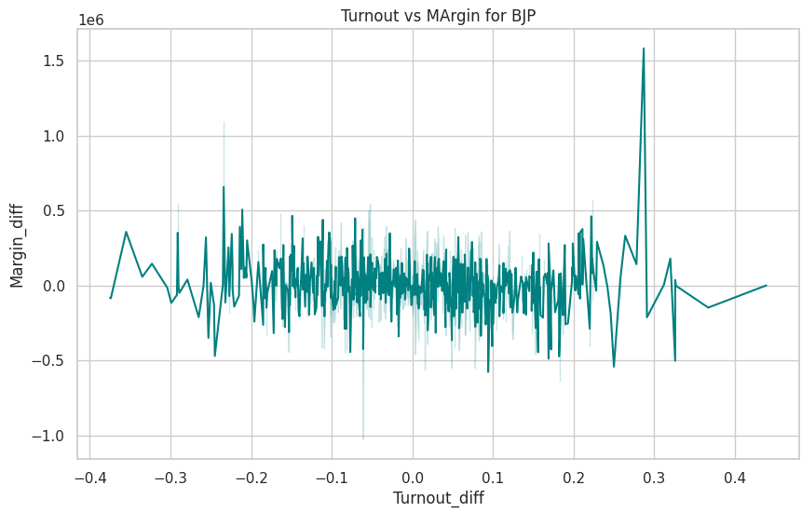
Winning Margin analysis
How does the voter turnout percentage vary across different states in the 2024 Lok Sabha election?

Slide 24
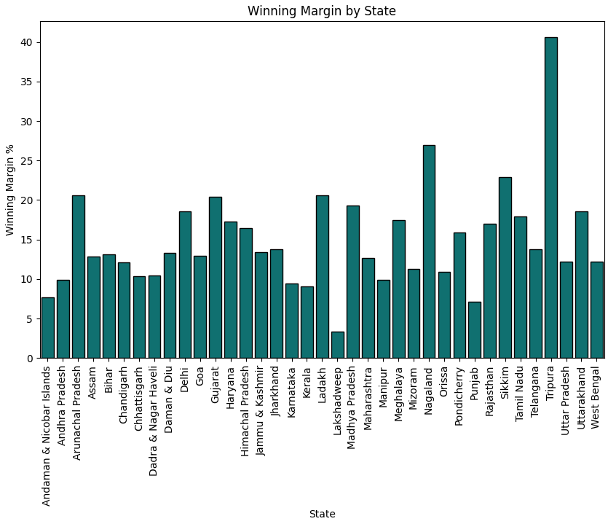
Analyzing voter turnout
How does the voter turnout percentage vary across different states in the 2024 Lok Sabha election?

Slide 25
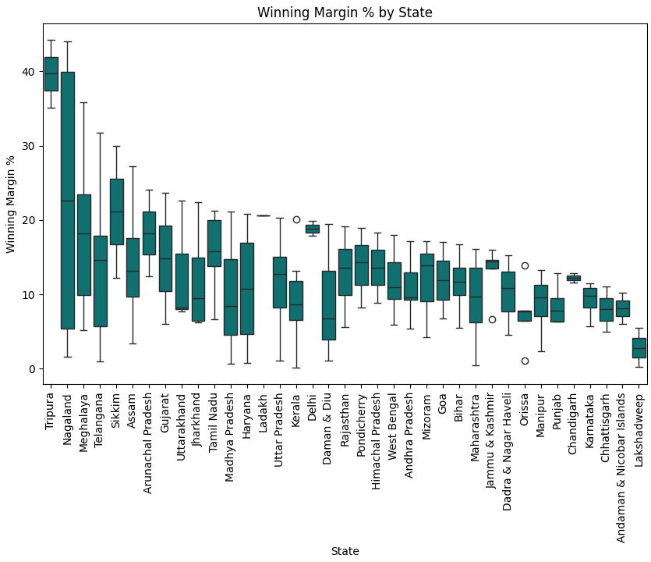
Analyzing voter turnout
How does the voter turnout percentage vary across different states in the 2024 Lok Sabha election?

Slide 26
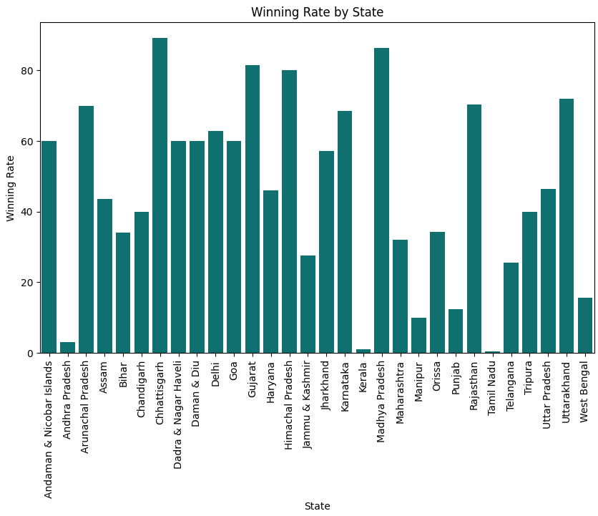
Analyzing voter turnout
How does the voter turnout percentage vary across different states in the 2024 Lok Sabha election?

Slide 27
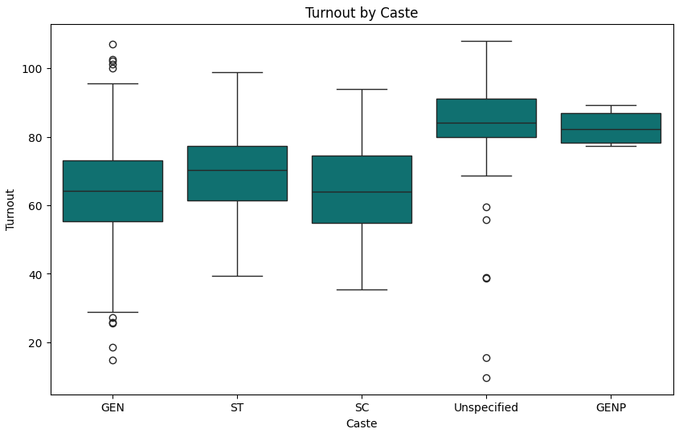
Winning margin by state
How does the voter turnout percentage vary across different states in the 2024 Lok Sabha election?

Slide 28
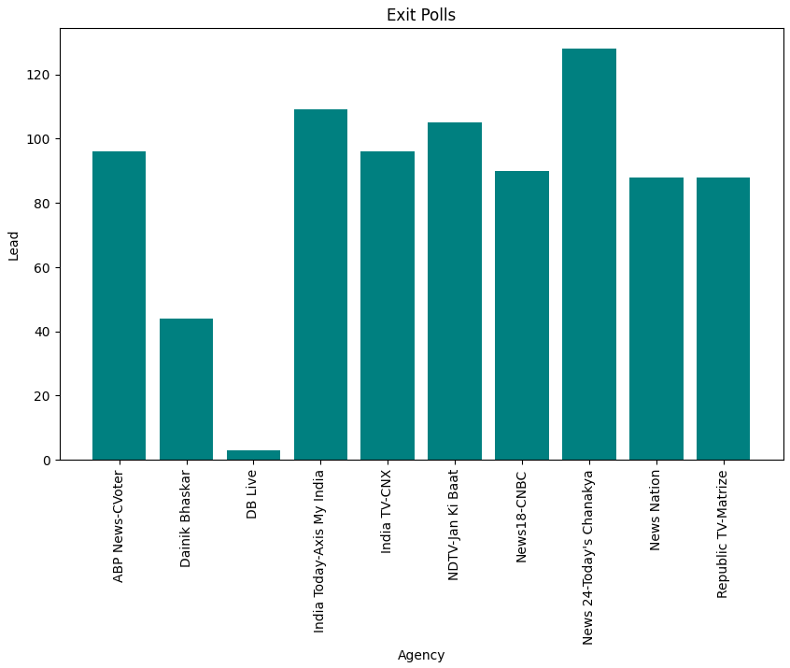
Winning Margin % by state
How does the voter turnout percentage vary across different states in the 2024 Lok Sabha election?

Slide 29
Winning rate by state
How does the voter turnout percentage vary across different states in the 2024 Lok Sabha election?

Slide 30
Turnout by caste
How does the voter turnout percentage vary across different states in the 2024 Lok Sabha election?

Slide 31
Exit polls
How does the voter turnout percentage vary across different states in the 2024 Lok Sabha election?

Slide 32
Chapter-3 Outcomes
3.1 Conclusion
The Lok Sabha Elections Analysis project has provided a thorough examination of India's parliamentary elections from 2004 to 2024, uncovering valuable insights into voter turnout, candidate demographics, and political party performance. Utilizing advanced data analysis and visualization tools, the project has shed light on regional voting patterns and demographic impacts, offering crucial information for political strategists, researchers, and policymakers. The findings from this project enable a deeper understanding of electoral trends and behaviours, aiding in the development of informed strategies for future elections.
3.2 Future Enhancement
Looking ahead, the project can be enhanced by incorporating real-time data analysis for more immediate insights into ongoing elections. Expanding the dataset to include more granular data, such as constituency-level details, could provide even richer insights. Additionally, integrating machine learning algorithms to predict election outcomes and voter behaviour patterns could significantly augment the project's analytical capabilities. Collaborating with social media platforms to analyze sentiment and its impact on elections could also offer a new dimension to the analysis, making it even more comprehensive and impactful.

Slide 33
Chapter-4 Bibliography
4.1 References
[1] https://www.kaggle.com/
[2] https://www.indiavotes.com/
[3] https://www.eci.gov.in/statistical-reports
[4] https://en.wikipedia.org/wiki/2024_Indian_general_election#Surveys_and_polls
[5] https://www.youtube.com/watch?v=PiFAa_jjaEI
[6] https://www.youtube.com/watch?v=Beozx9pUajA
[7] https://www.youtube.com/watch?v=RGOj5yH7evk
[8] https://www.youtube.com/playlist?list=PLc20sA5NNOvrsn3a78ewy2VTCXVV47NB4
[9] https://www.youtube.com/watch?v=XVv6mJpFOb0
[10] https://www.youtube.com/watch?v=8dTpNajxaH0
[11] https://www.youtube.com/watch?v=2hPCX-p_X8Q
[12] https://www.youtube.com/watch?v=mBoX_JCKZTE
[13] https://www.youtube.com/watch?v=UOsRrxMKJYk

Slide 34
4.2 Website and GitHub Link
After completing my data analysis tasks, all links of google colab were uploaded on the GitHub.
Also, created a website and hosted it on GitHub, where insights from project were shared. Used Html, CSS, JavaScript to create website. Power Bi dashboard for the project was embedded on the website.
Link To Our Website:
https://20ayush04.github.io/Lok_Sabha_sys/
GitHub Link for All Tasks:
https://github.com/20ayush04/Lok_Sabha_sys

